Slide 1


The most livable city in THE uk
Team Data Diggers:
Yifang Zhou
Richa Ranjan
Anton Okhotnikov
Shihuai Wang
Daniel Pelnar

Slide 2
CONTENTS
01
Aim
02
Implementation
03
Analysis
04
Result
05
Application
06
Limitation

Slide 3
AIM
Finding the important/relevant factors that influence livability of cities (citizen’s happiness level)
01
Designing an interactive application to predict the most livable city based on an individual’s preferences of factors
02

Slide 4
IMPLEMENTATION
16 datasets in total : (weather, traffic, entertainment, infrastructure)
UK Government data, Online Survey conducted, etc.
Scrapy open source data
Data Collection
Data Cleansing
Missing data handling- replace with average or zero
Techniques Treating illegal characters, missing values by Python
Data Normalization
Z-score method
Data Management
MongoDB

Slide 5
ANALYSIS
Selecting Factors that determine the City Rank
LASSO or Random Forest
What we need? Importance ranking of factors
Why not LASSO? Linear/Ranking?/No selection
Advantage of Random Forest: Non-linear/Ranking!
01
Factors | Correlation Coefficient
School | 0.810281
Hospital | 0.726583
Stations | 0.686357
University | 0.662404
Factors | Correlation Coefficient
School | 0.374345
Hospital | 0.198825
Stations | 0.170241
University | 0.108700
02
Correlationship between two factors
Pearson’s Correlation Coefficient
E.g. strong correlation with population

Slide 6
RESULTS
16 datasets in total : (weather, traffic, entertainment, infrastructure)
UK Government data, Online Survey conducted, etc.
Scrapy open source data
Data Collection
Data Cleansing
Missing data handling- replace with average or zero
Techniques Treating illegal characters, missing values by Python
Data Normalization
Z-score method
Data Management
MongoDB

Slide 7
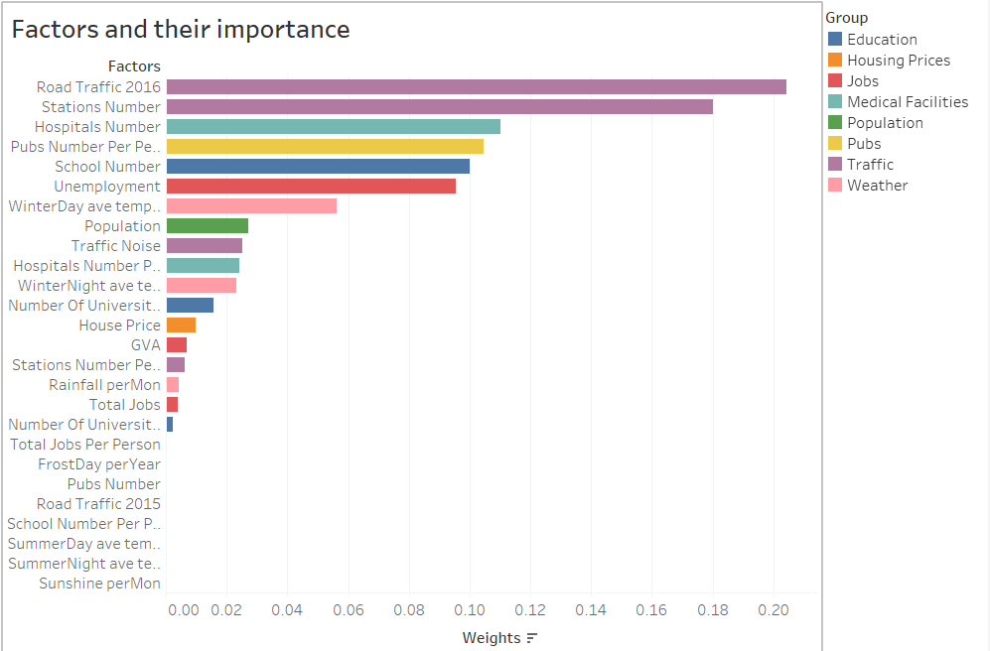

Slide 8

APPLICATION
Web application
HTML & CSS & Python
The user enters age, gender, job, location and other factors and the results are displayed based on similar parameters obtained from the survey.
User’s factor ranking is also taken as an input
User input
Algorithm
(${Score}_{city}=\sum_{i}^{k}{r_{i}∙{w1}_{i}∙V_{i}}$)
Prediction of top-3 most liveable cities for person based on his/her preferences.
Output

Slide 9
LIMITATIONS
Limited datasets:
data for some factors are available only for 2015 and 2016
Small data sample:
the number of cities considered is 84 and the survey responses are also a small sample size.
01
02
Limited datasets: data for some factors are available only for 2015 and 2016
The Alogrithm is not suitable
03
04

Slide 10

Questions?

Slide 11
Thank you for listening!
PPT模板下载：www.1ppt.com/moban/ 行业PPT模板：www.1ppt.com/hangye/
节日PPT模板：www.1ppt.com/jieri/ PPT素材下载：www.1ppt.com/sucai/
PPT背景图片：www.1ppt.com/beijing/ PPT图表下载：www.1ppt.com/tubiao/
优秀PPT下载：www.1ppt.com/xiazai/ PPT教程： www.1ppt.com/powerpoint/
Word教程： www.1ppt.com/word/ Excel教程：www.1ppt.com/excel/
资料下载：www.1ppt.com/ziliao/ PPT课件下载：www.1ppt.com/kejian/
范文下载：www.1ppt.com/fanwen/ 试卷下载：www.1ppt.com/shiti/
教案下载：www.1ppt.com/jiaoan/ PPT论坛：www.1ppt.cn
Team Data Diggers:
Yifang Zhou
Richa Ranjan
Anton Okhotnikov
Shihuai Wang
Daniel Pelnar

